Slide 1

LOAN DEFAULT CLASSIFICATION Under The Guidance: Prof. Chaojie wang
Capstone Project by-
Narendra Thumma
Rakesh Reddy Pulichinthala
Vaishnavi Vejella

Slide 2
Presentation Details
Vaishnavi- Introduction, Results and conclusion
Narendra- Briefing on Machine learning models used
Rakesh- Explanation of EDA results

Slide 3

Introduction
Lending money has long been a popular way to make money from money.
This activity is being pursued by financial banking institutions and numerous individuals in order to gain money.
After conducting extensive research, we discovered that, with technologies such as decentralization finance and other technologies in place, a data-driven approach is required to close the gap in the banking sector in terms of lowering the burden of bad debts and improving the credit history of applicants.

Slide 4
Dataset
Data source: https://www.kaggle.com/yasserh/loan-default-dataset
The Dataset contains of 20+ columns namely:
Column | Description
ID | Customer ID of Applicant
year | Year of Application
loan_limit | Cash Flow or Net Cash Flow type
gender | Applicant's gender
approv_in_adv | Is loan pre-approved or not
loan_type | Type of loan
loan_purpose | Purpose of loan
Credit_Worthiness | Credit worthiness of the applicant
open_credit | Type of Credit (Open credit or Non open credit)

Slide 5
Column | Description
business_or_commercial | Usage type of the loan amount
loan_amount | The exact loan amount
rate_of_interest | Rate of interest of the loan
Interest_rate_spread | Spread of interest rate by banks
Upfront_charges | Up front loan sanctioning charges
lump_sum_payment | Down payment for the loan
property_value | Collateral value
construction_type | Collateral construction type
age | Age of applicant
Security_Type | Type of Collateral
status | Loan status (Approved/Declined)

Slide 6


Literature review
The literature on estimating default risk in Finance can be divided into two categories based on the strategy used.
Conventional mathematical models including as ordinary least squares (OLS) are used in the primary area of research to investigate the various factors determining the risk .
Researches have investigated a significant amount of study in the area of Finance using data from various platforms to predict the likelihood of effective financing, loan interest rates, and payment difficulties.

Slide 7
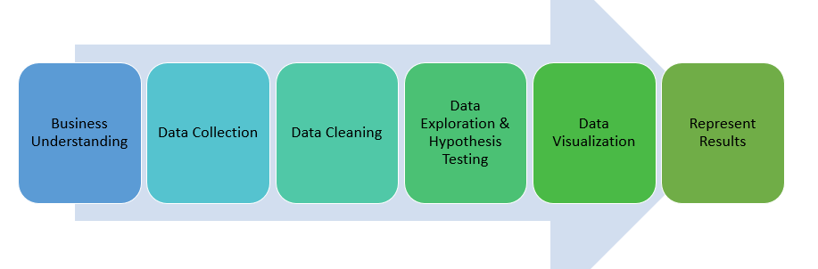
Research Process

Slide 8

Exploratory data analysis

Slide 9
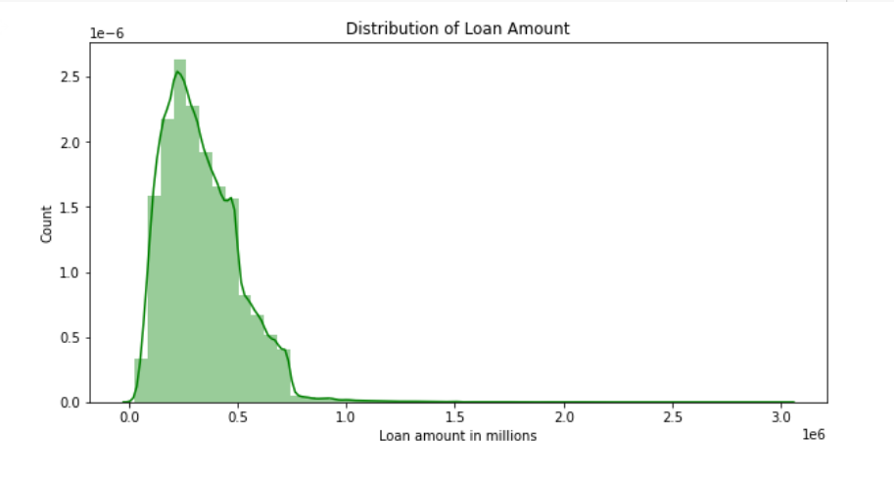
1. distribution of loan amounts:
Most of the values of loan applications are in the ranges between $250 K to $500 K.

Slide 10
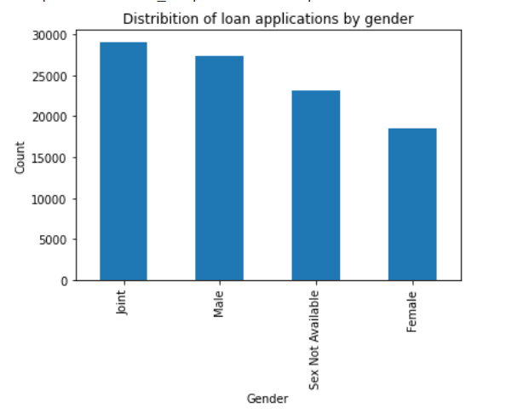
2. Analysis on Distribution of loan applications by gender:
We can conclude that the joint applications (i.e., both male and female) are the highest and individually male applications are higher than females.

Slide 11

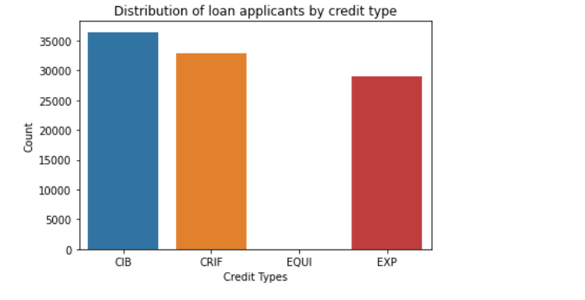
3. Analysis on Distribution of loan applicants by credit type:
The loan applications with 'CIB' & 'CRIF' are the highest when compared to other two types.

Slide 12
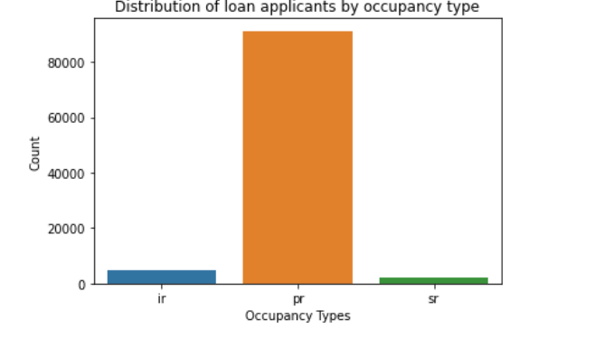
4. Analysis on Distribution of loan applicants by occupancy type:
Ir =Industrial, pr=Personal, sr=Structural (Used for various commercial activities)
The loan applications with occupany_type 'pr' are the highest when compared to the other types of occupancies.

Slide 13
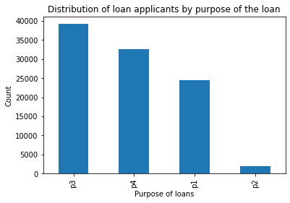
5. Distribution of loan applicants by purpose of the loan:
The purposes 'p3','p4' types are the highest among other loan applications.
The purposes 'p3','p4' types are the highest among other loan applications.
p1= Commercial
p2= Structural Services
p3= Personal
p4= Industrial

Slide 14

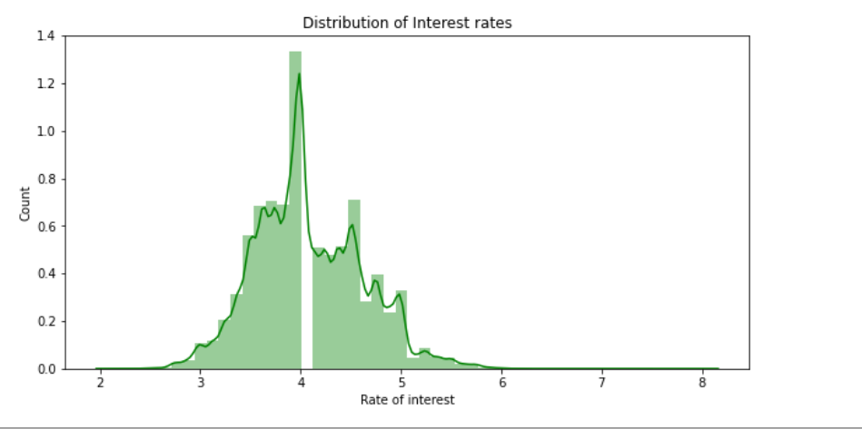
6. Analysis on distribution of Interest rates:
The interest rates for most of the loans are in the range between 3 and 5.

Slide 15

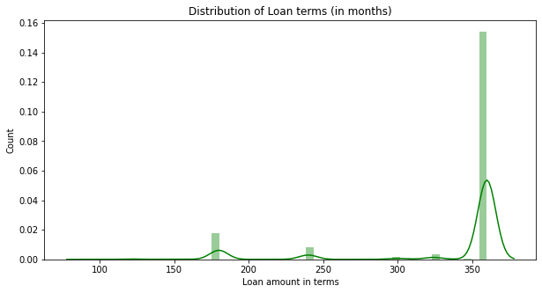
7. Distribution of Loan terms(in months):
Most of the loan terms are in the range of 300 to 400 months i.e., 30 years approx.

Slide 16

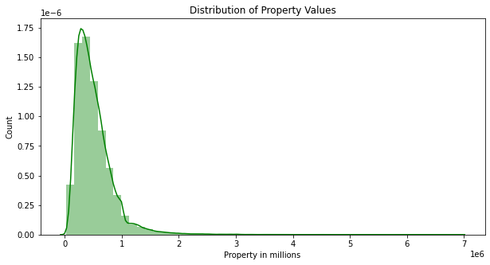
8. Distribution of Property values:
The values of the collateral properties for loan applications are in the ranges of $100k to $1000K.

Slide 17

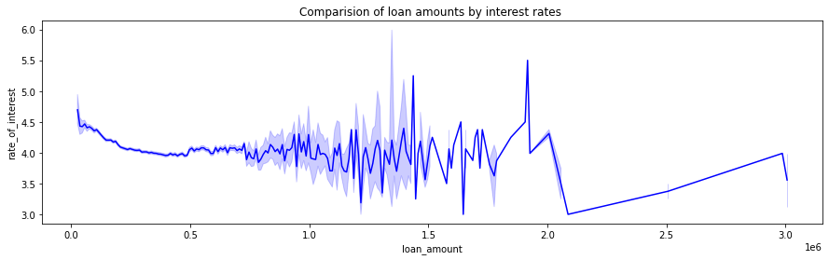
9. Comparison of loan amounts by interest rates :
The is no steady interest rates. We can see that the interest rates floats with respect to the loan amounts.

Slide 18

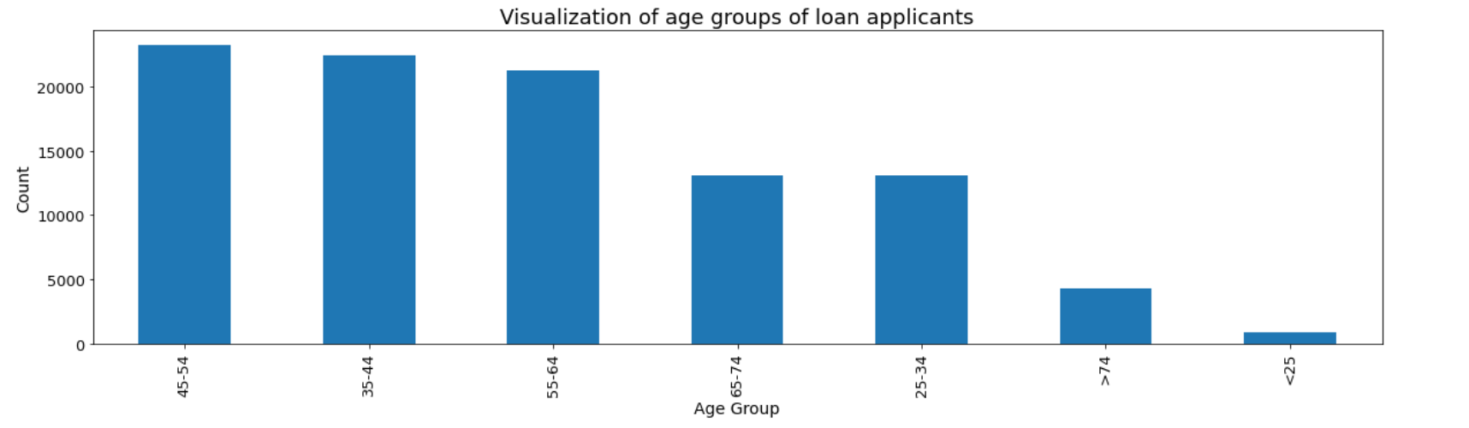
10. Analysis on age groups of loan applicants:
The age of the loan applicants are in the range of 45-54 followed by applicants are of the ages 35-44.

Slide 19

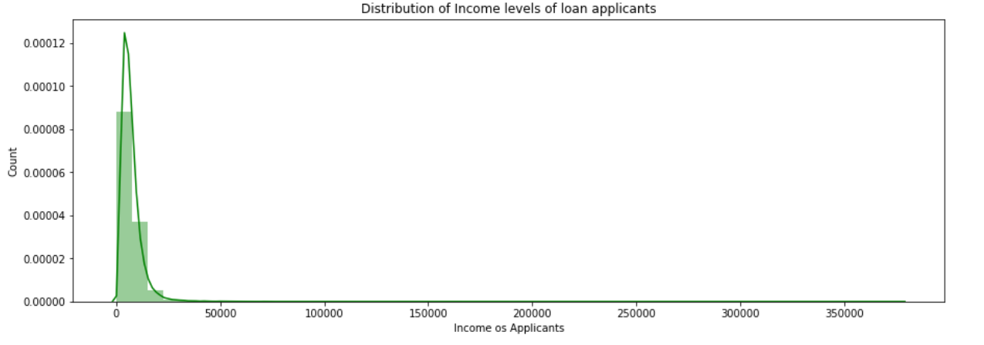
11. Distribution of Income levels of loan applicants:
The income ranges of loan applicants are in the range of $0 to $20000 per month.

Slide 20

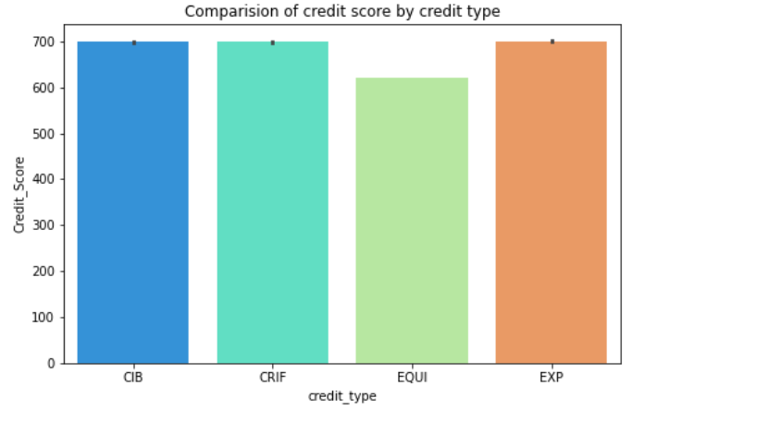
12. Analysis on credit score by credit type:
The credit scores of the credit type CIB,CRIF is higher then followed by credit type EXP.

Slide 21
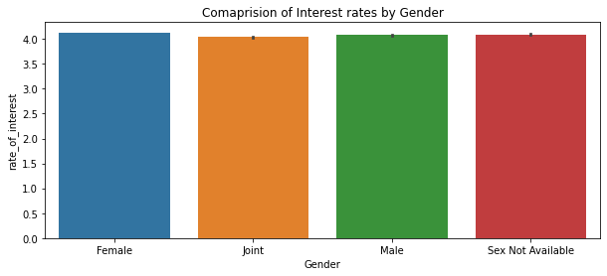
13. Comparison of Interest rates by Gender:
We can determine that the interest rates for loan applications does not vary by gender.

Slide 22
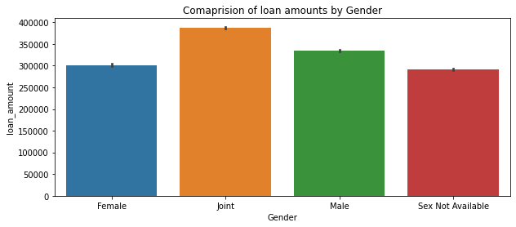
14. Comparison of loan amounts by Gender:
We can understand that the loan amount for joint loan applications are higher then followed by male applicants.

Slide 23
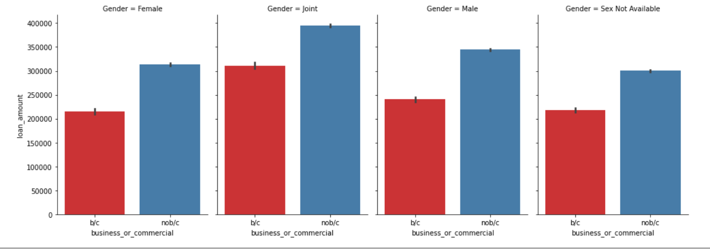
15. Analysis on loan amount by the gender of applicants type and nature of loan availability:
We can infer that most of the loan applicants are for commercial purposes in any genders. We can also infer that there are male applicants for business purposes than females.

Slide 24

Feature ENGINEERING
1. Chi Square test-
The Chi-Square test is best defined as a statistical hypothesis test. This test is used either for comparing a group having a value or in comparing multiple groups with categorical data. The advantages of this test are the robustness with respect to the given data.
It can only be used when two categorical variables are there and related to some population. The Chi-square test is a goodness fit statistic because it measures how well the observation data fits the distributed data.
2. Z-score:
A Z-score is a hypothesis test. The samples are normally distributed while the test is being performed. It's only utilized when the standard deviation is known, and the sample size is always large.
In other words, it verifies the sample's hypotheses about the same population.

Slide 25
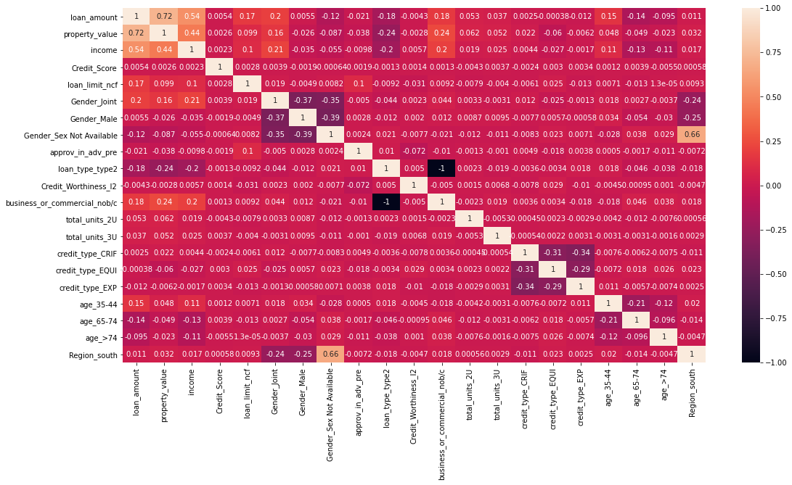
correlation matrix

Slide 26

Machine learning models

Slide 27
Evaluation metric: ROC _AUC Score
ROC AUC SCORE is used primarily for slightly imbalanced datasets. As our target variable has some degree of imbalance, it's good to use ROC AUC score as our evaluation metric.
The ROC AUC score gives us a score to determine how well the model has predicted the instances correctly.
Since, we are working on a real estate domain, it's important that our model predicts number of correct instances, in order to future develop on the model and use it in practical applications. Hence, ROC AUC Score is the best metric to determine the predictive power of the model.

Slide 28
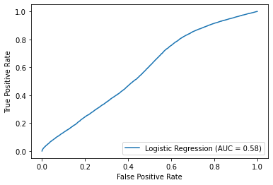
Logistic regression:

Slide 29
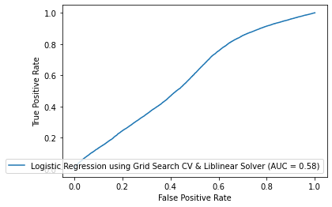
Logistic Regression using Grid Search Cross Validation & Liblinear solver:

Slide 30
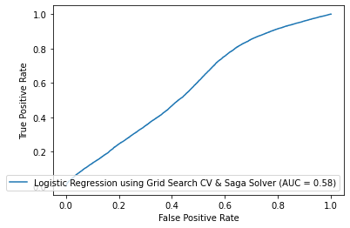
Logistic Regression using Grid Search Cross Validation & SAGA SOLVER:

Slide 31
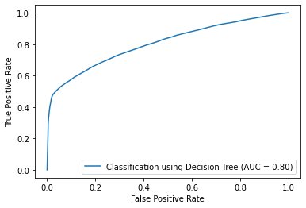
Decision Tree:

Slide 32
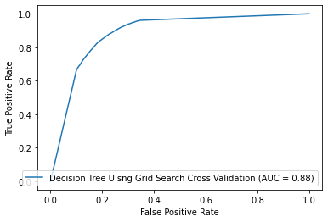
Decision Tree Using Grid search cross visualization :

Slide 33
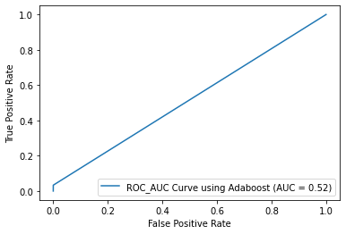
Adaboost model:

Slide 34
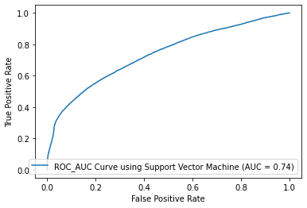
Support Vector Machine:

Slide 35
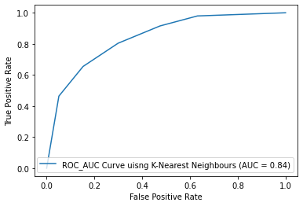
K- nearest Neighbor:

Slide 36
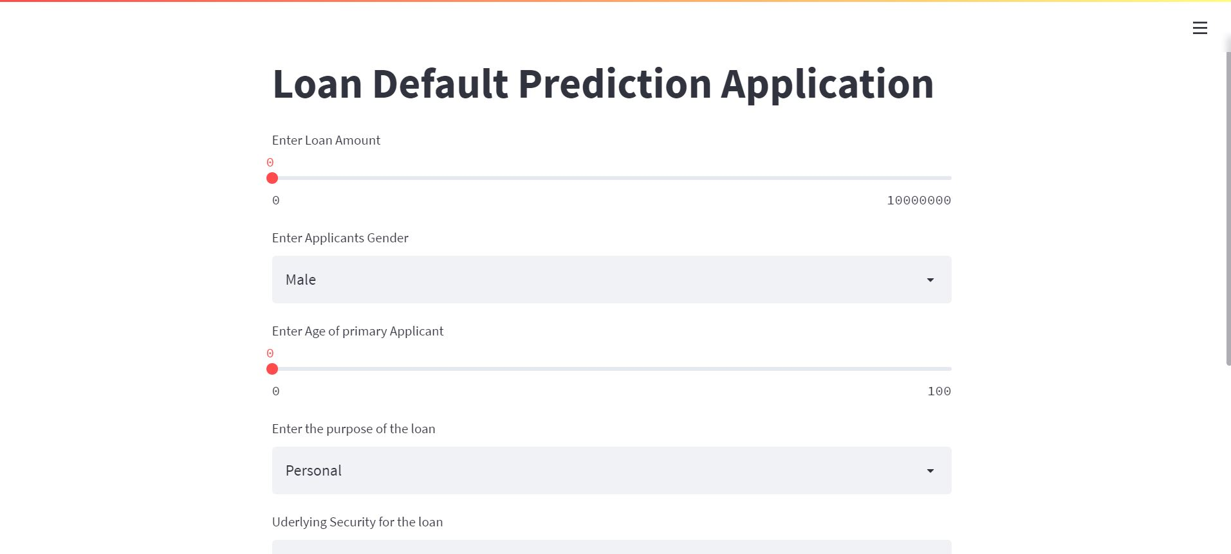
FRONT END UI FOR USERS:

Slide 37
Results and conclusions
The classifier's efficiency to identify the model is determined by the Area Under the Curve (AUC) Score.
Initial AUC score using logistic regression model is 58 percent, that implies that the model is 58 % efficient in determining the target classes.
Using Logistic Regression with Grid Search Cross Validation & Liblinear Solver, the AUC value is still 58%.
By applying Logistic Regression with Grid Search CV & Saga Solver is also having the same AUC value, which is 58%.
Upon applying Decision trees classification model, the score has improved to 80%.
Then again, we executed Decision tree with grid search cross validation which gave a score of 88%.
With the Adaboost model, we got ROC_AUC score of 52%, which is way less comparing to decision tree and logistic regression models.
After implementing Adaboost model, we implemented Support vector model which gave a score of 74%..
Lastly, we used K- Nearest Neighbors model that enhanced the ROC_AUC score around 84%.
On concluding, decision tree classifier has the highest score. Thus, we use this model for further deployment when implanting with live application.

Slide 38
References:
Heitzmann, P. (n.d.). Predicting loan defaults using Machine Learning Classification models. Data Science Blog. Retrieved February 27, 2022, from https://nycdatascience.com/blog/student-works/predicting-loan-defaults-using-machine-learning-classification-models/
Banerjee, T. (2019, December 24). Classification model for loan default risk prediction. Medium. Retrieved February 27, 2022, from https://medium.com/analytics-vidhya/classification-model-for-loan-default-risk-prediction-98c2cc7ef1bf
Xu, Z. (J. (2022, February 10). Loan default prediction for profit maximization. Medium. Retrieved February 27, 2022, from https://towardsdatascience.com/loan-default-prediction-for-profit-maximization-45fcd461582b
Notes:
1.

Slide 39


